Slide 1
Annotation for Transparent Inquiry
Presentation at “Technical Solutions to Advance Evaluation and Replication in the Social Sciences: What’s New, What's Next,” August 29, 2018
QDR, Syracuse University

Slide 2
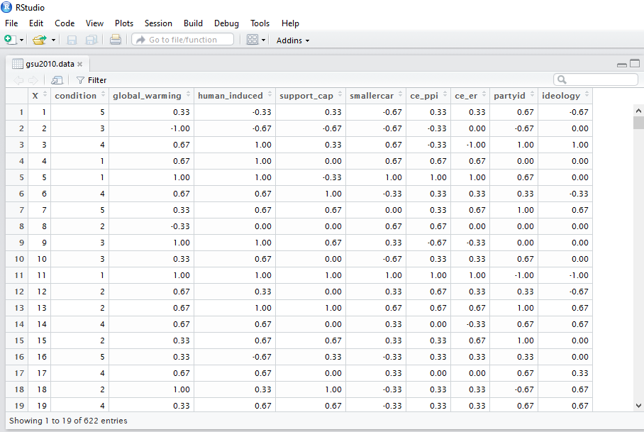


Quantitative Research: Matrix Data
Open Science
Toby Bolsen, Thomas J. Leeper, and Matthew Shapiro. 2014. “Doing What Others Do: Norms, Science, and Collective Action on Global Warming.” American Politics Research 42(1): 65–89.
Notes:
Quantitative and computational social science analyze numeric data arranged in a matrix and approached as an aggregate body of information. In published work, the analysis is typically summarized in tabular form in the text or appendix, and the study dataset (and relevant information about its creation) and the do-file used for analysis are customarily provided as supplemental materials.

Slide 3
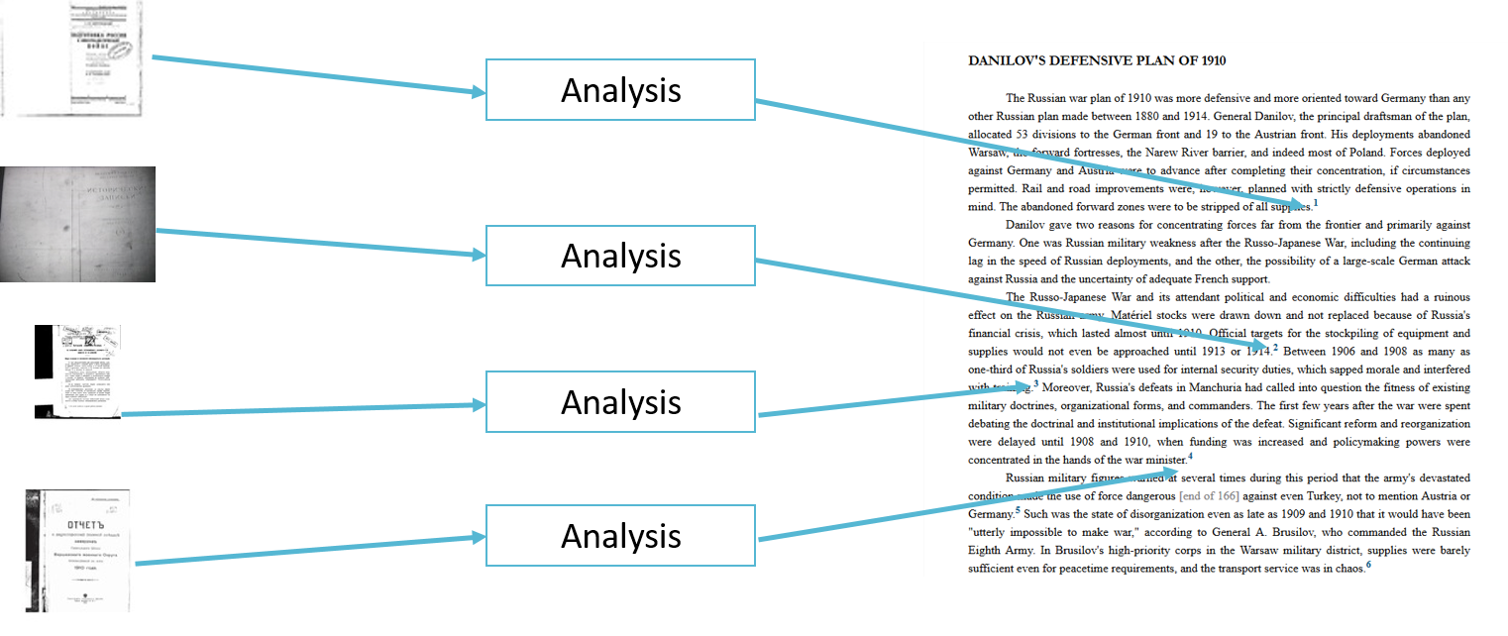
Qualitative Research: Granular Data
Notes:
Qualitative data and analysis work differently. Qualitative data are often richer and more abstract, and are typically analyzed, and used to support claims, individually or in small groups. In this type of analysis, the content of each cited source (e.g., book, archival document, interview transcript, newspaper article, video clip, etc.) serves as a distinct input. Moreover, data, analysis, and conclusions are densely interwoven across the span of a book or article. The nature and form of qualitative research thus poses unique challenges for transparency.

Slide 4
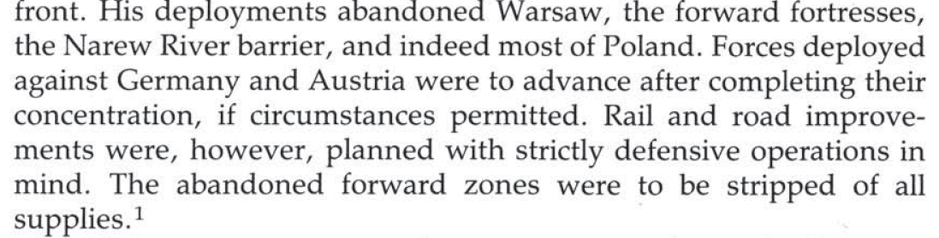
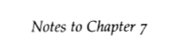
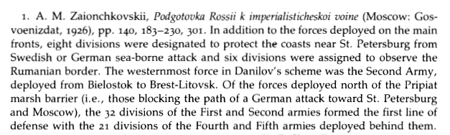
The Traditional Way

Slide 5
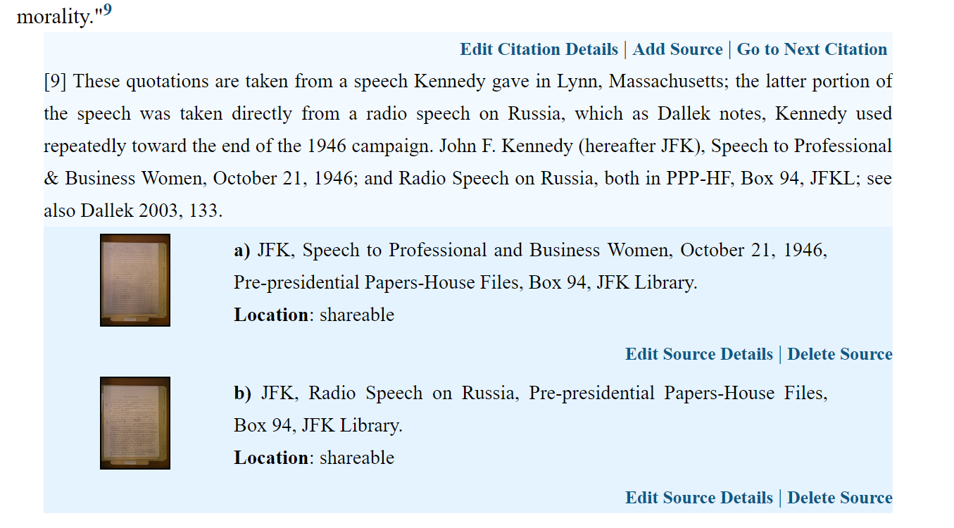
Initial Approach: Active Citation

Slide 6
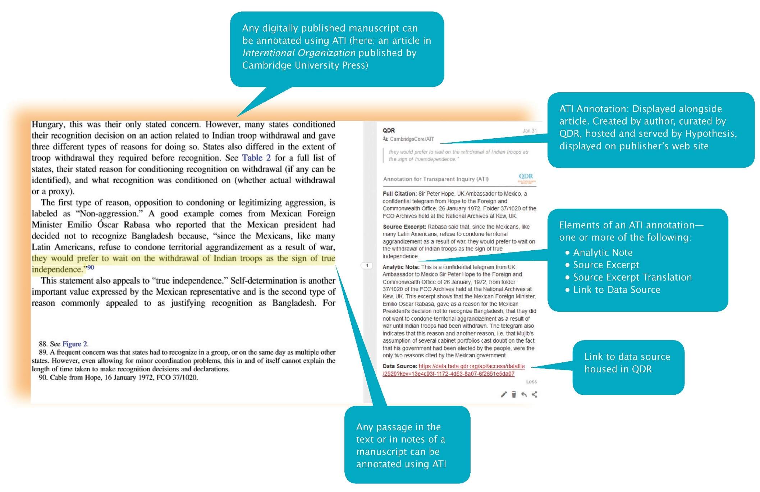
Annotation for Transparent Inquiry (ATI)
Notes:
Qualitative transparency calls for annotations and the underlying data sources to which they link to be tightly integrated with articles. This requires close coordination with publishing platforms. This raises a potential problem, however, as publishers are ill-equipped to assume the role of hosting and serving annotations and data sources. Playing that role effectively requires the capacity to treat both annotations and data sources in accordance with current best practices of open science: they must be curated so that they are FAIR (findable, accessible, interoperable, and reusable) to the extent permitted by law and ethics, and they must be hosted in a sustainable venue where their long term preservation is guaranteed (e.g., updated versions of files are provided when the software designed to access them changes). Making annotations and data sources FAIR thus entails tasks and responsibilities that go well beyond what most publishers can deliver. “Missing link” is provided by open annotations.

Slide 7
ATI: Specialization and Synthesis
Allows each institutional stakeholder to focus on their strengths, and avoids using scarce resources for other tasks.
Journals publish articles on their websites.
QDR (or another trusted digital repository) curates and preserves the annotations and sources.
Hypothesis serves the annotations.

Slide 8
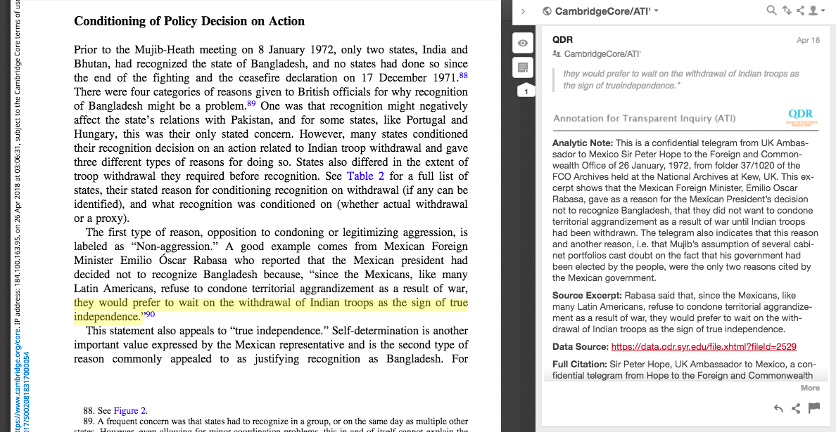
ATI: The journal
Notes:
Journals are digitally published on publishers’ webpages. Business model is not affected. Paywalled material stays paywalled.

Slide 9
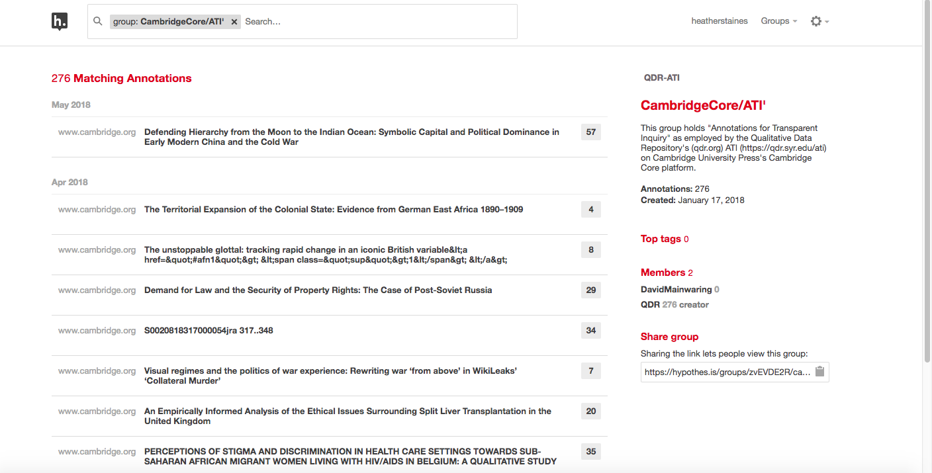
ATI: Annotations
Link: Group Activity Page
Notes:
Hypothes.is—a leader in shaping open annotation standards and developing applications to facilitate their use—produces the software used for ATI and provides technical support in ingesting and serving annotations, ensuring a smooth end-user experience.

Slide 10
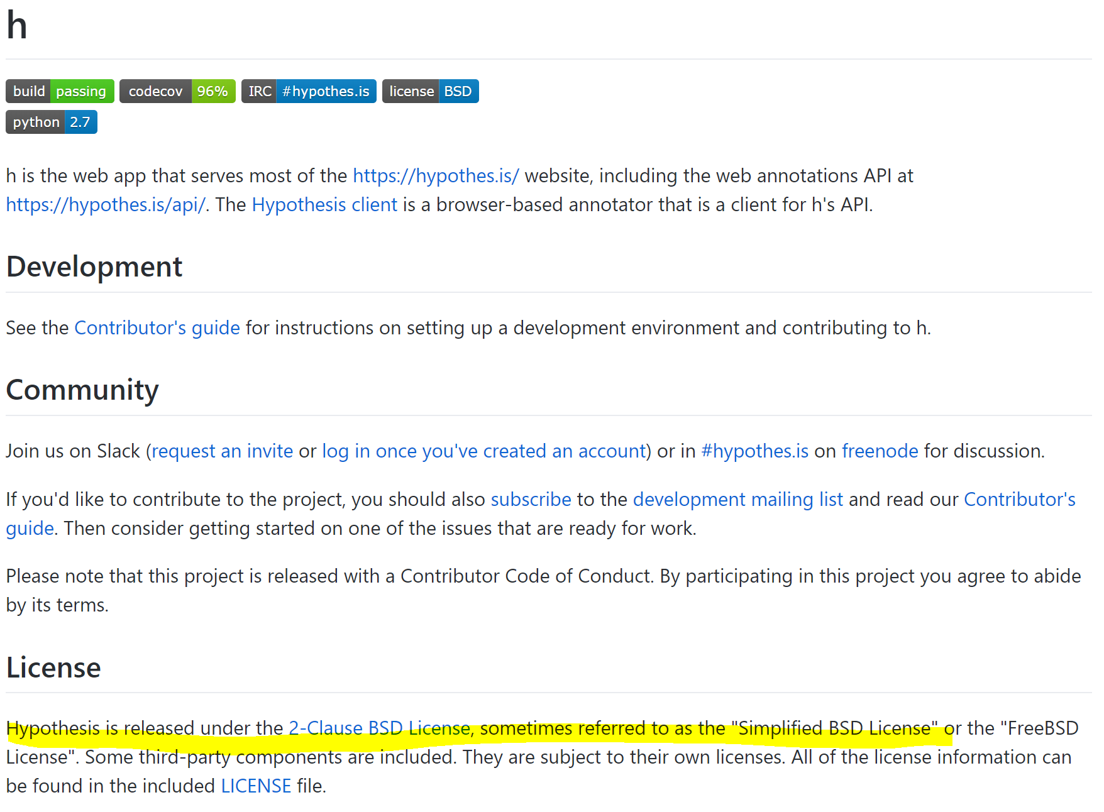
ATI: Hypothesis is Open Source & Non-Profit
Notes:
Hypothesis is a non-profit software company, and its software is open source.

Slide 11
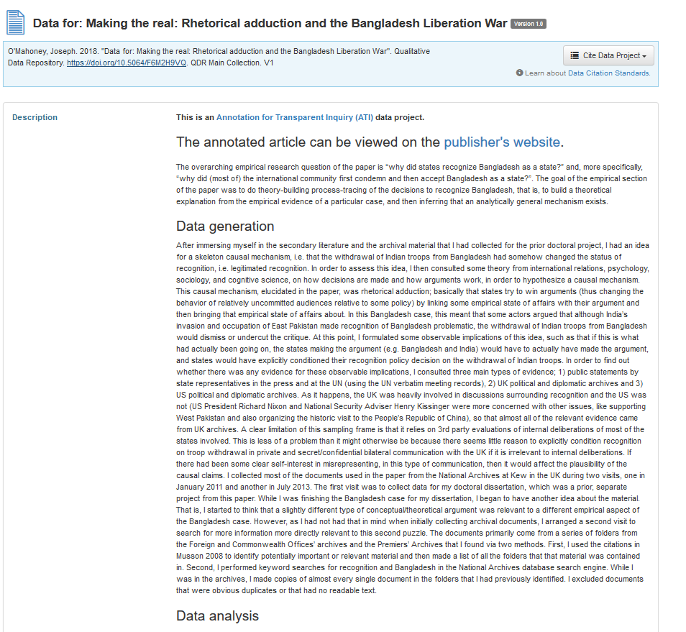
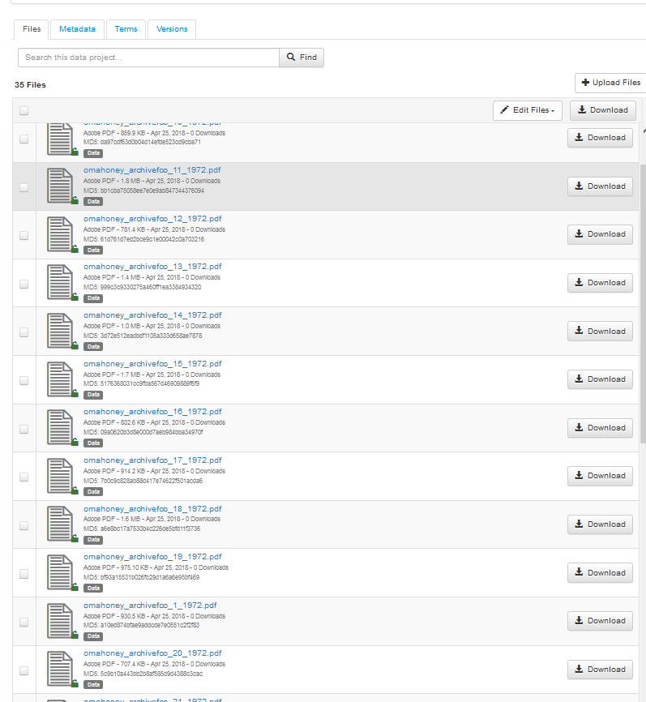
ATI: Data repository
Notes:
QDR is committed to long term preservation, to applying appropriate access controls if data sharing needs to be restricted, and to maintaining the links between web-based publications and their annotations and data sources (e.g., providing updated versions of data source files as technology changes). Our goals are to render data findable, accessible, interoperable, and reusable (FAIR). Accomplishing these goals involves a set of related technologies and policies, and requires substantial expertise and investment. Digital repositories are best equipped to consistently comply with evolving standards for making data interpretable and properly caring for them, for example, describing them with the proper metadata, and employing digital preservation strategies that assure the usability of data in the long run.

Slide 12
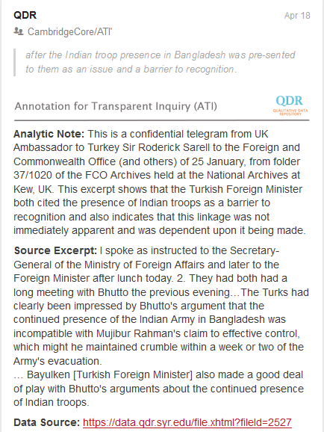
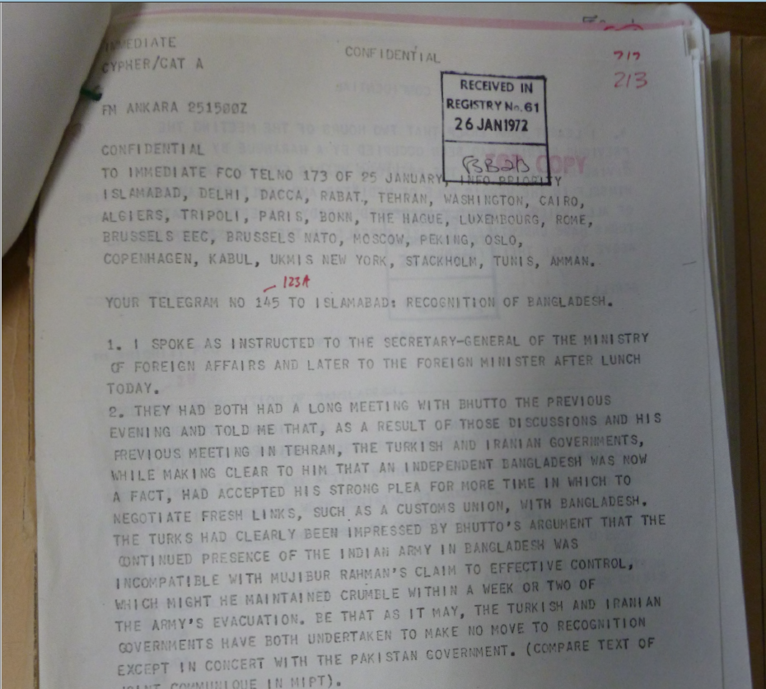
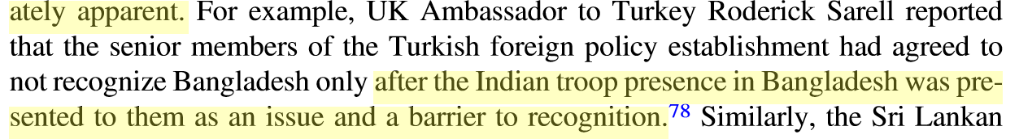
ATI example: Historical research
Source document
Annotation
Publication
Link: http://bit.do/ati-historical

Slide 13
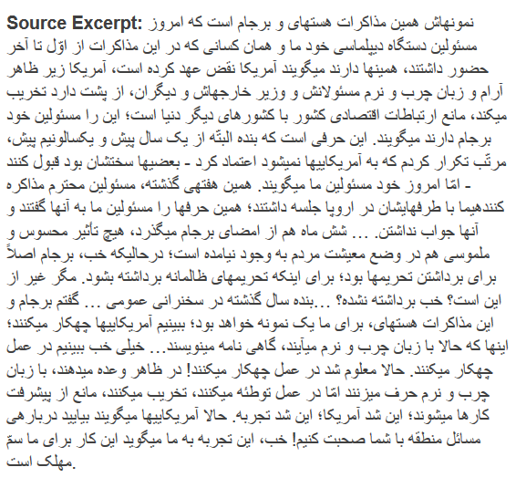
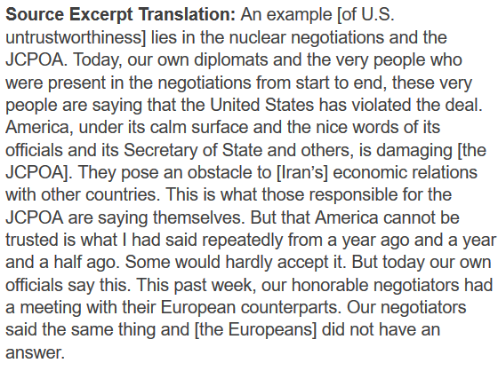
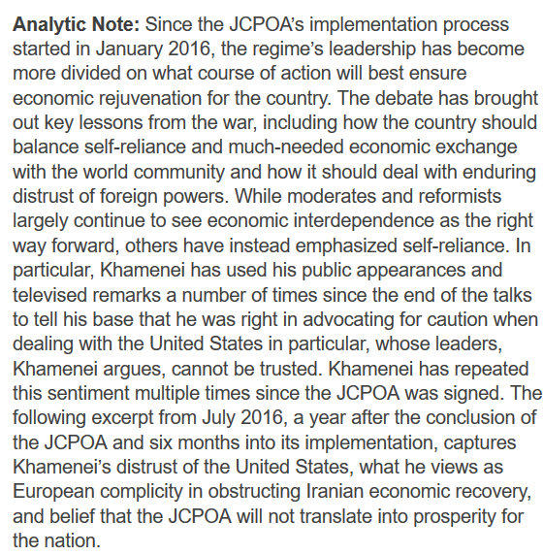
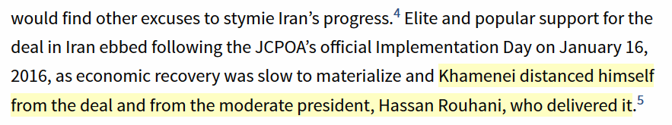
ATI Example: Excerpt, translation, and analysis
Source excerpt
Translation
Analysis
Publication
Notes:
Example from MIT Press’ journal, International Security.

Slide 14
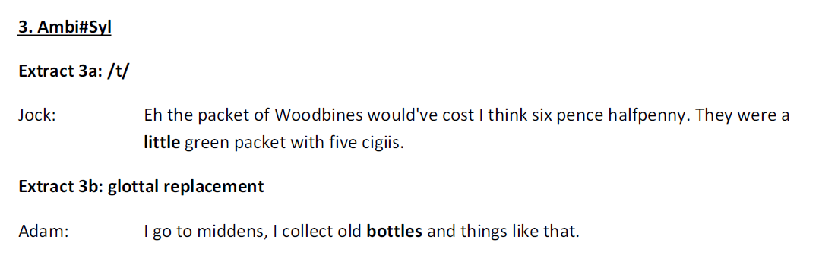

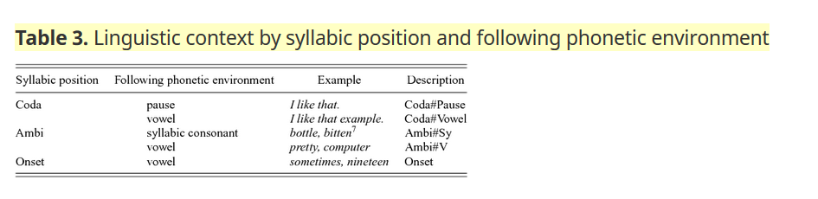
ATI Example: audio in linguistics
Documentation (list of excerpts)
Data source (audio)
Publication table
Link: http://bit.do/ati-audio
Notes:
Direct link to snippet video: https://drive.google.com/open?id=1gjAdy0BSgqHJ_eQ1s6FwPNf_frnF-OZX
Direct link to raw sound file: https://drive.google.com/file/d/1uYwDxQmV24ERBBBktSy8nnrhnWQvCjJa/view?usp=sharing
Link to annotation: https://hyp.is/UvONqAaYEeibFZ8epLi12g/www.cambridge.org/core/journals/english-language-and-linguistics/article/unstoppable-glottal-tracking-rapid-change-in-an-iconic-british-variable-1/B466B1578FAC33B1B4E1FFD0A538513D/core-reader

Slide 15
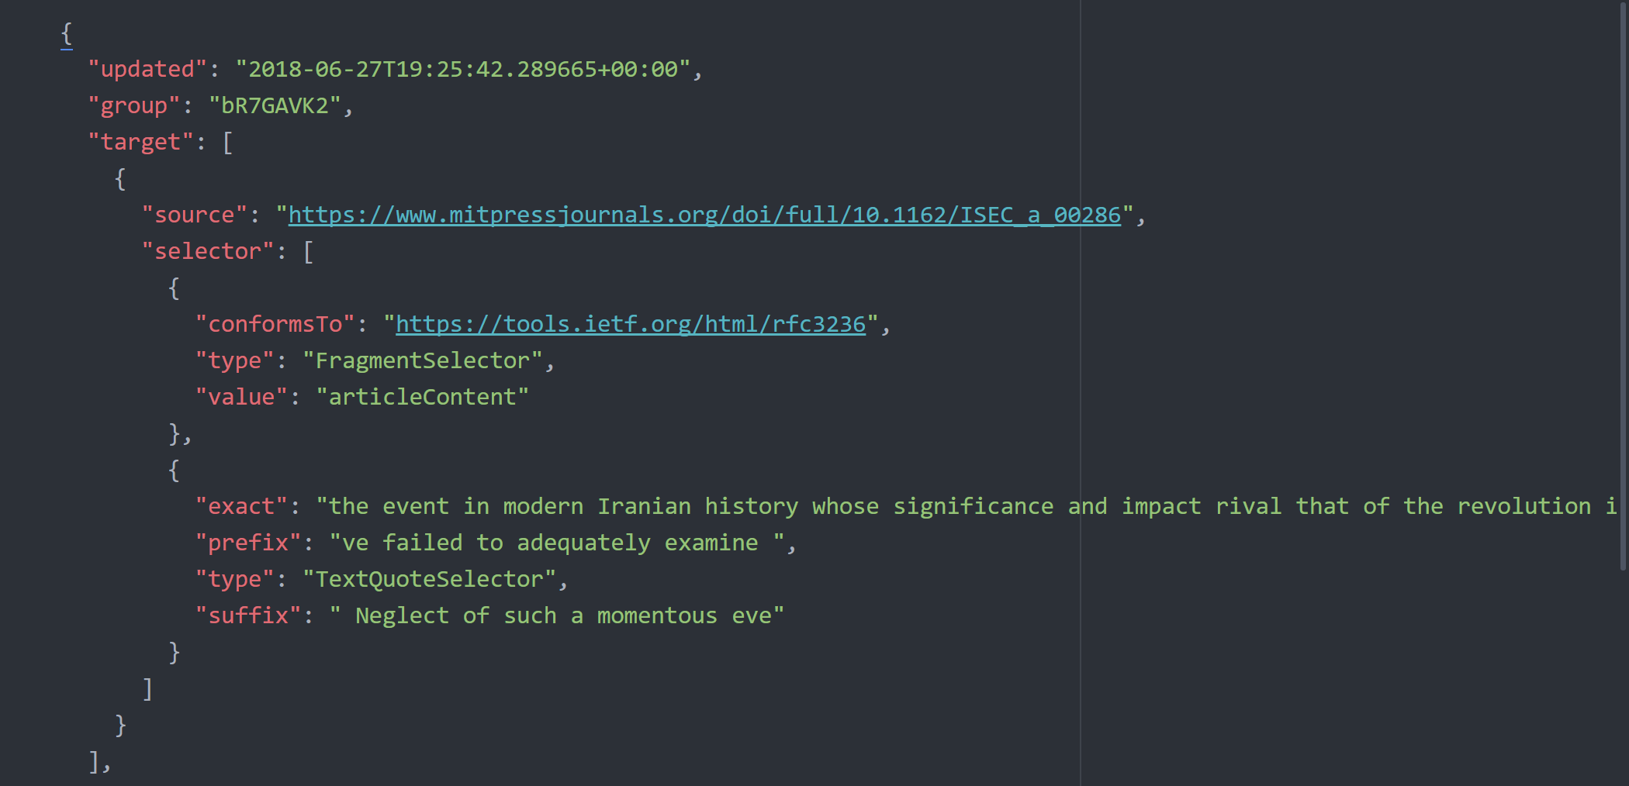
Annotations under the hood: JSON (1)

Slide 16
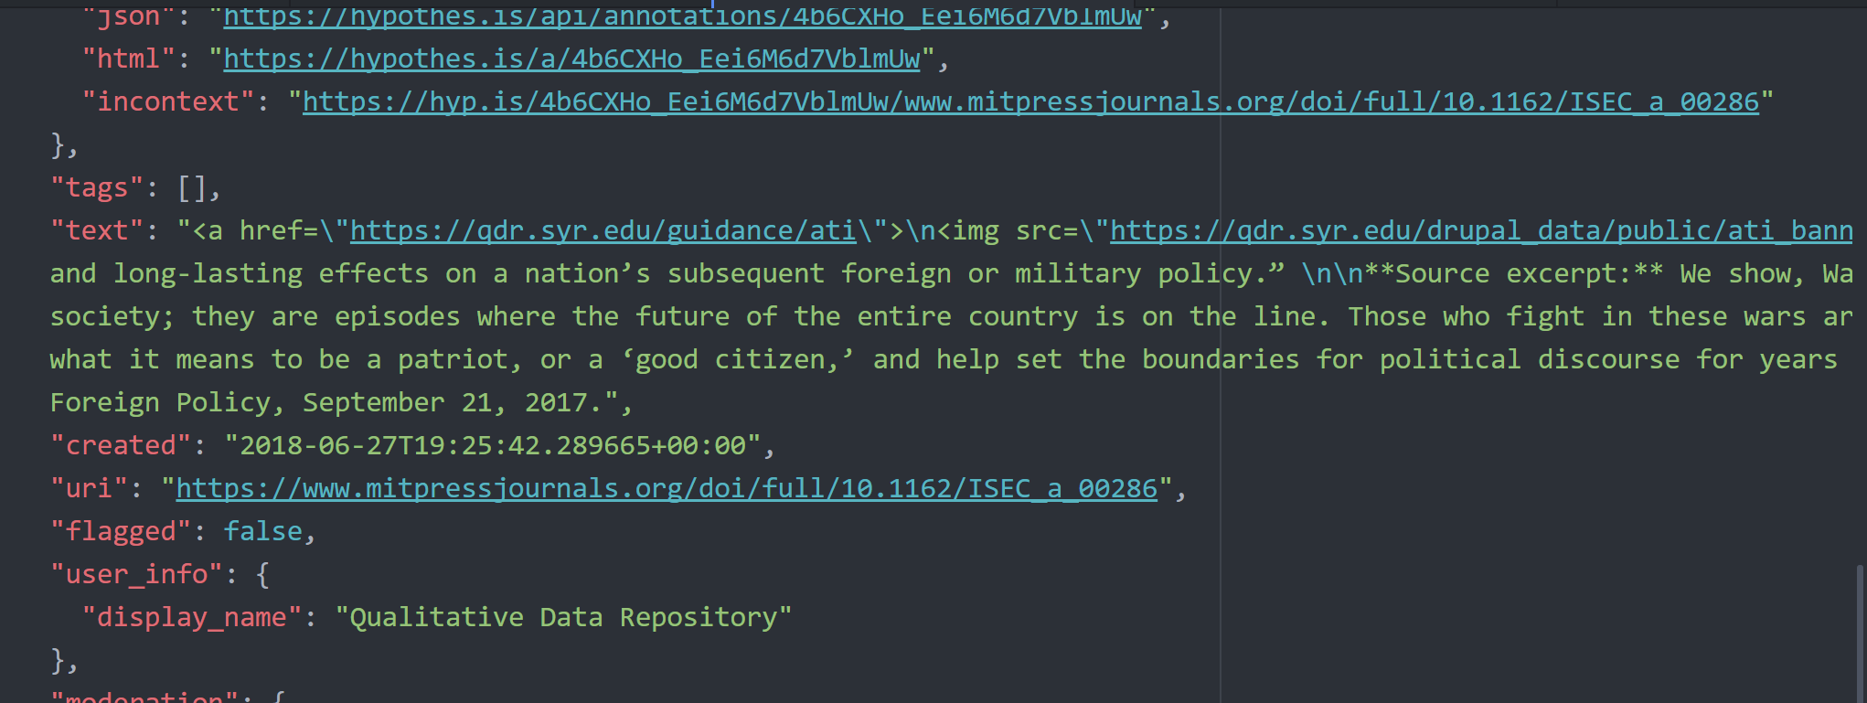
Annotations under the hood: JSON (2)

Slide 17
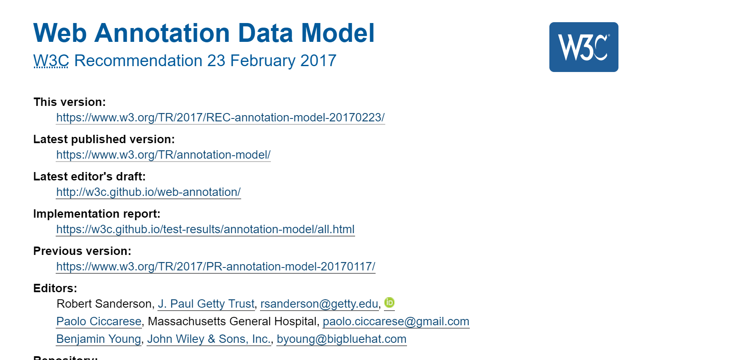
Standard Compliant

Slide 18
Evaluating ATI: The ATI Initiative
2 Phases; currently beginning of 2nd
1st phase: Annotating recently published articles
Collaborated closely with Cambridge University Press to test technology, workflows, and solicit articles
Projects available at qdr.org/ati/ati-models
2nd phase: Annotating during writing process
Every paper paired with reviewer, pre- and post review
Authors keep logbook & fill out survey
Very preliminary results

Slide 19
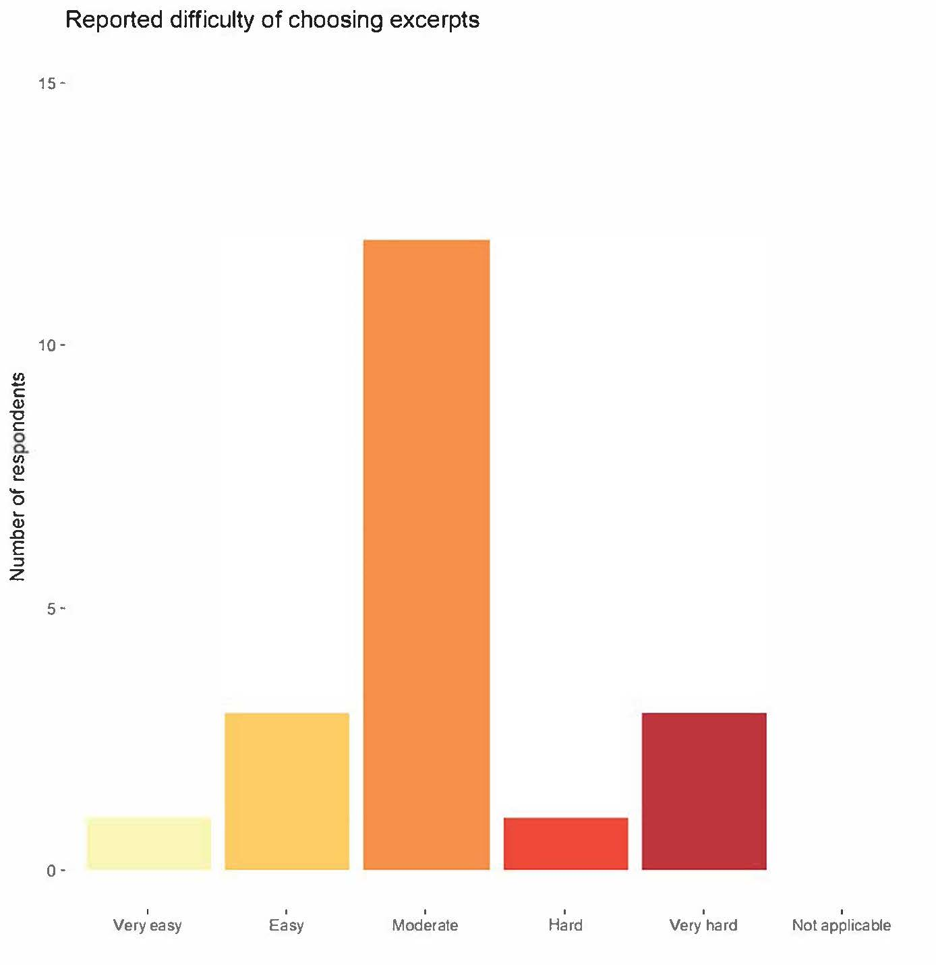
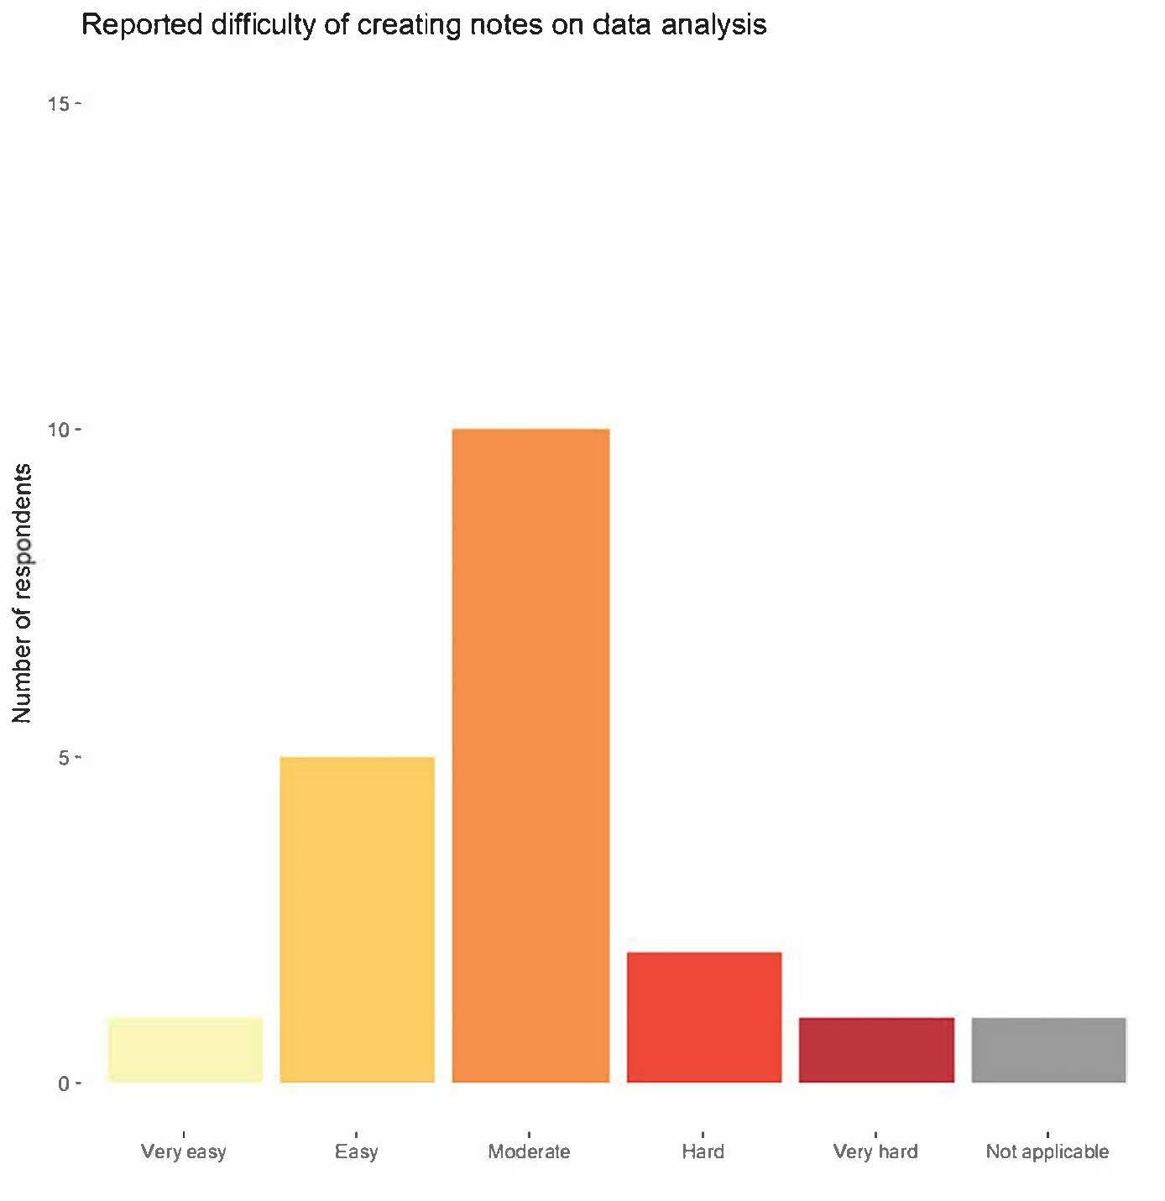
Evaluating ATI
Average time spent per project: ~20hs

Slide 20
Evaluating ATI
Relatively poor match between reviewer expectation and annotations
Widely differing number of annotations (6-80/article)
Widely differing usage of annotations, some disagreement
Concern about incentives
Interest in clearer typology of annotations
Existing work on annotation/citation ontologies

Slide 21
ATI Challenge
2nd Phase of pilots
Solicited proposals for (paid) annotation & workshop
80 submissions across disciplines & continents, though skewed towards political science
Selected 18 projects, workshop in November

Slide 22
ATI: Overcoming Complications
Basic model for core services is in place and working well.
Gradually expanding to more use-cases, overcoming technological hurdles as they are identified (for example, proxy servers for off-campus sign-in; journal aggregators like Muse).
Addressing “socio” part of socio-technical infrastructure, in particular making ATI more consistent with existing norms and practices (for example, hybrid paper-digital publications).

